Slide 2
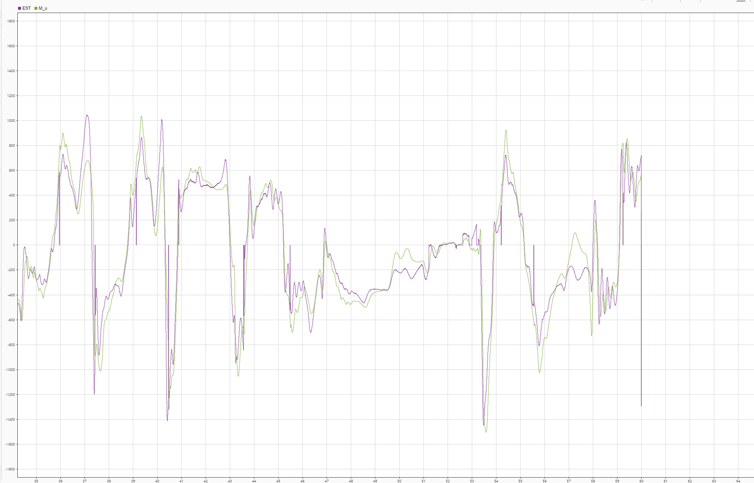
LSTM(10) layer(2)

Slide 3
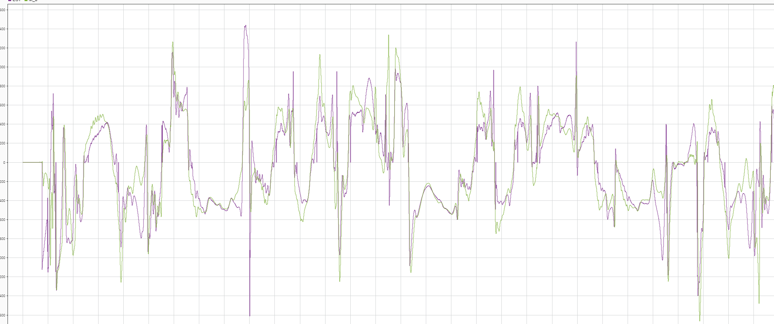
LSTM(40) layer(2)

Slide 4
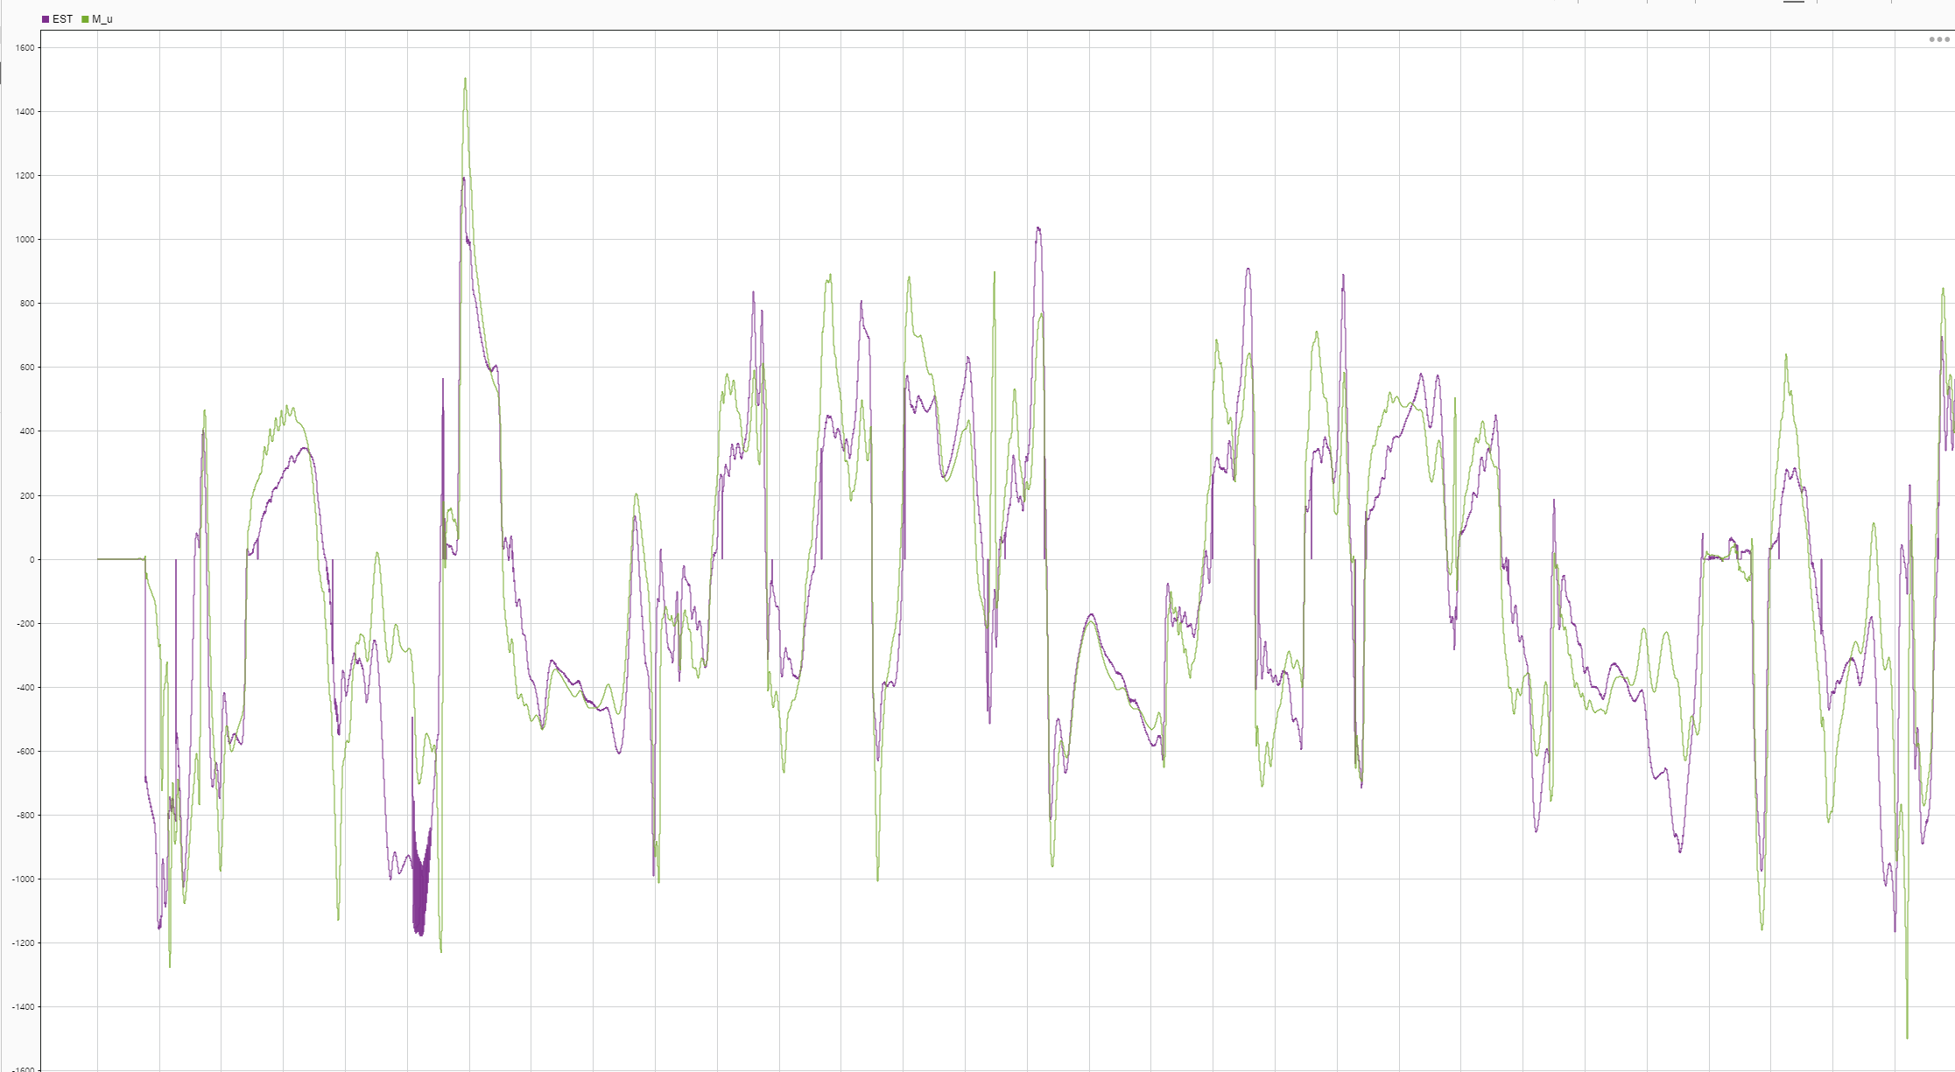
LSTM(10) layer(1)

Slide 5
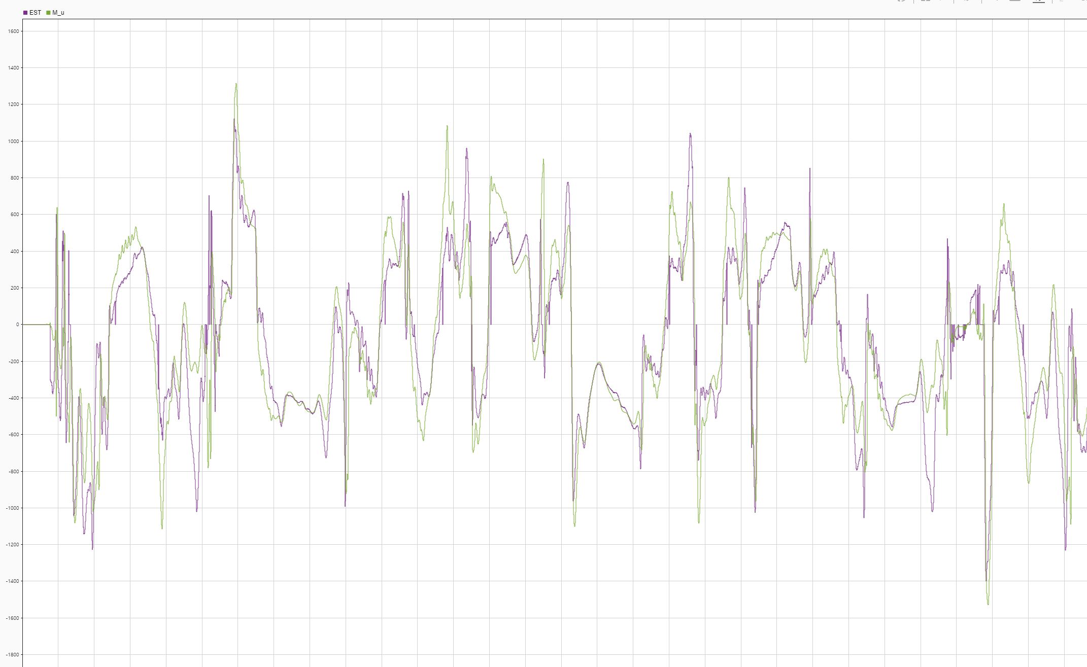
LSTM(40) layer(1)

Slide 7
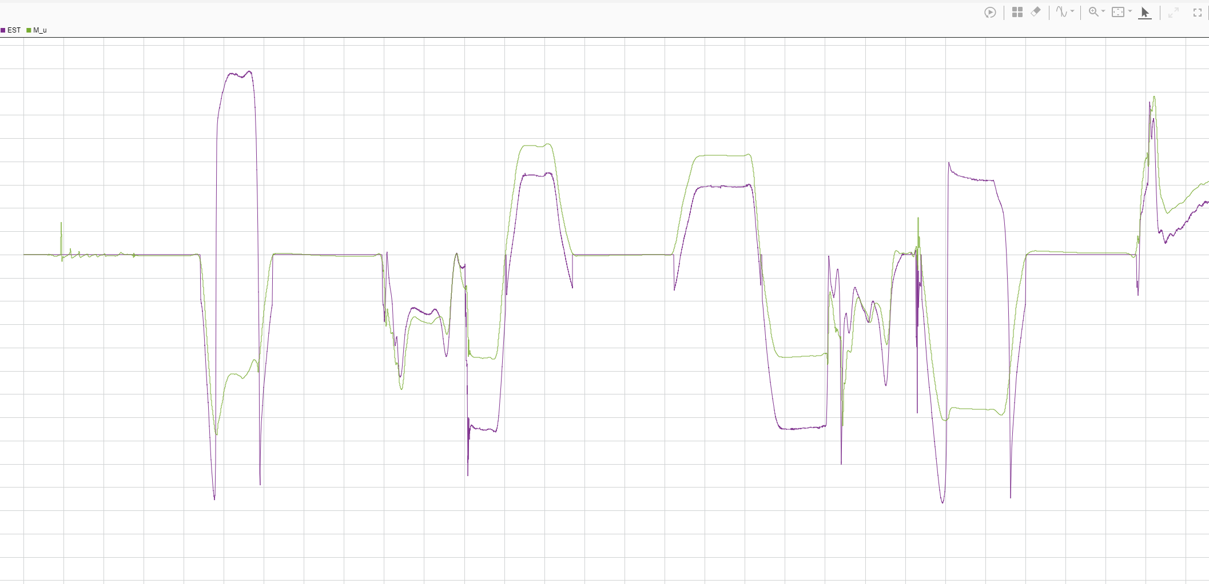
LSTM(10) layer(2)

Slide 8
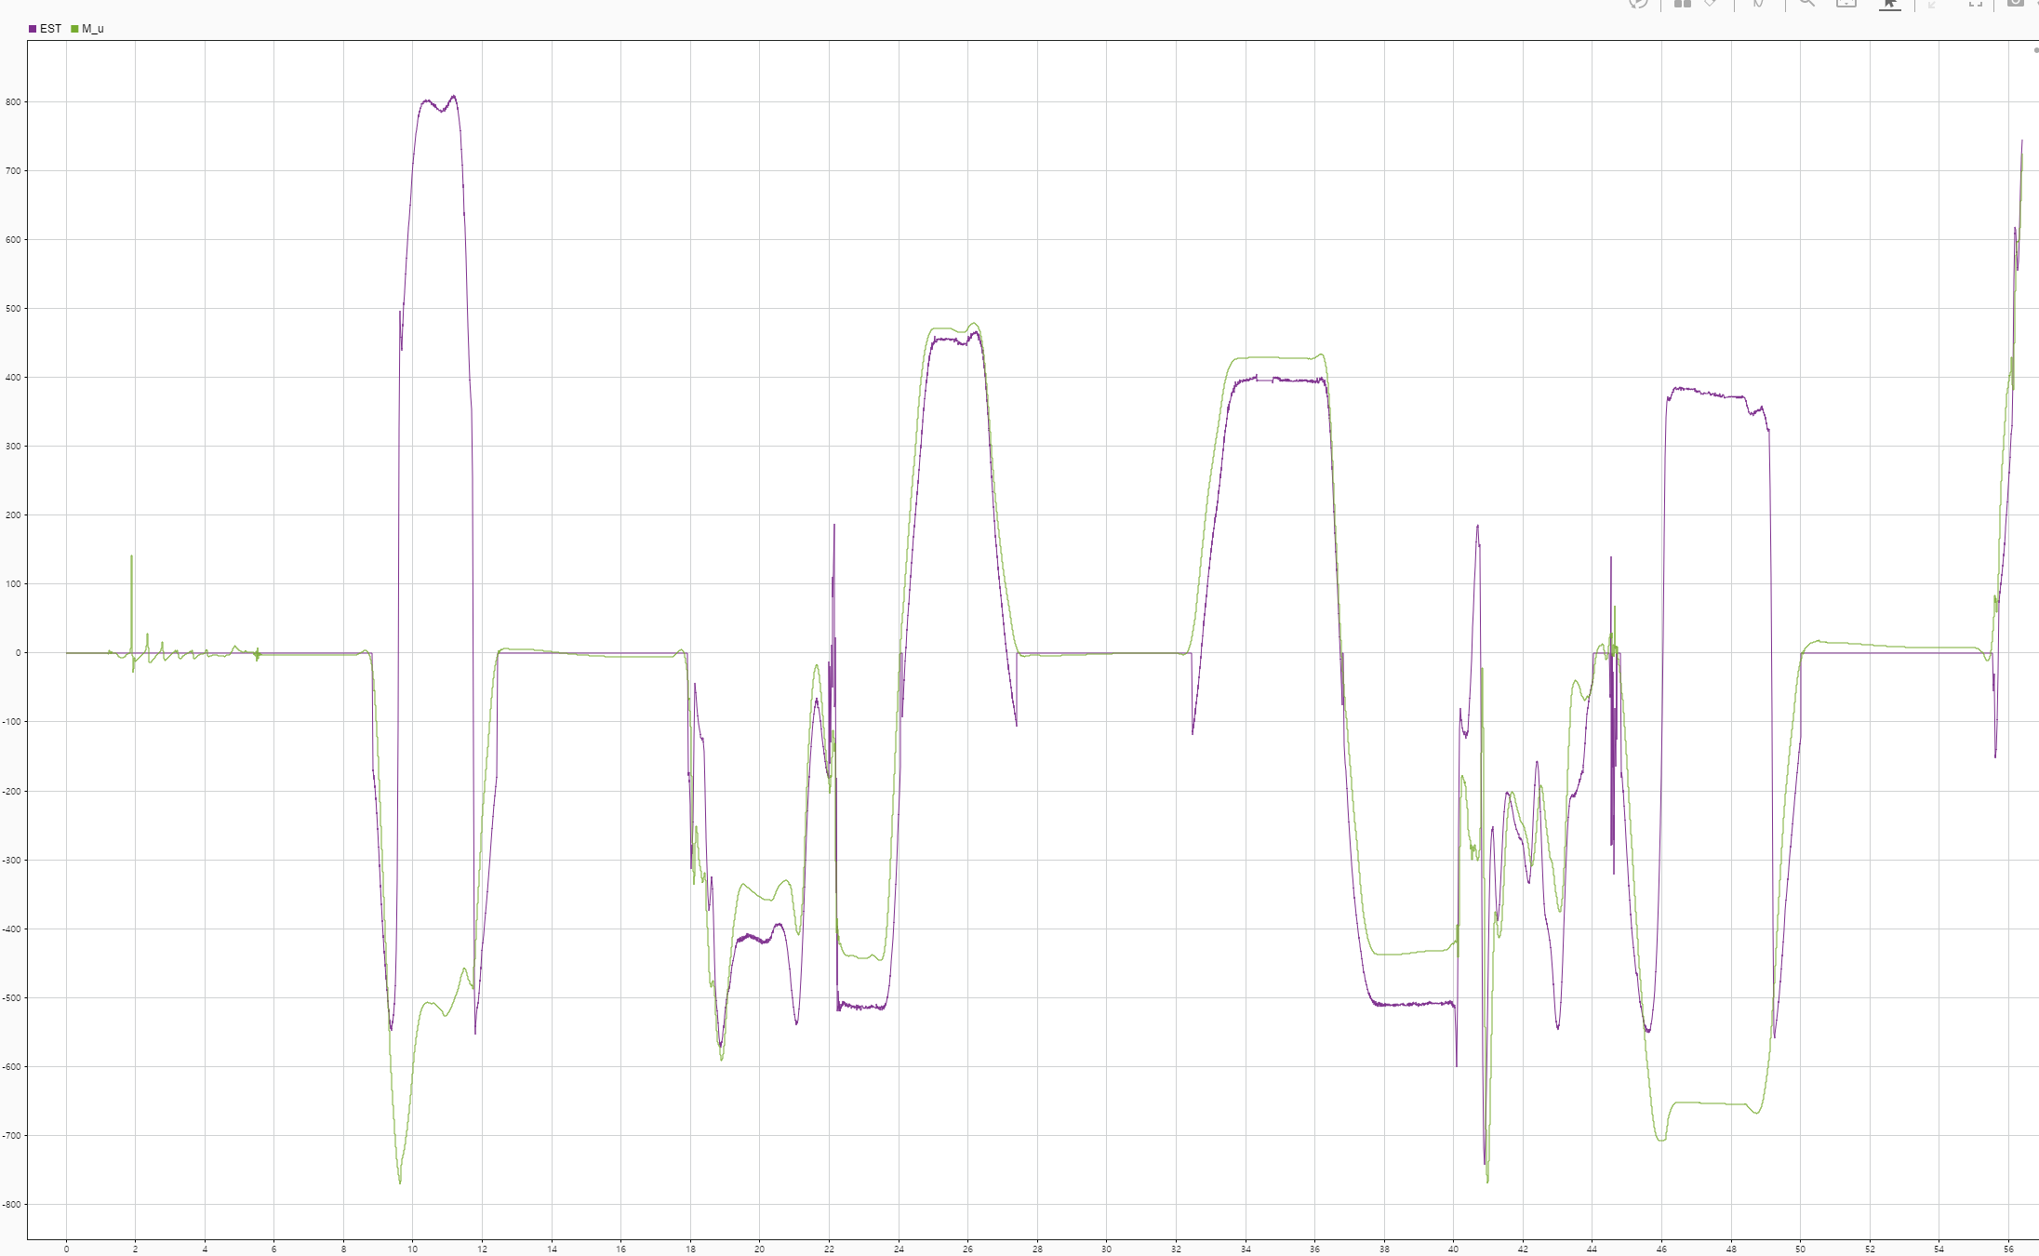
LSTM(40) layer(2)

Slide 9
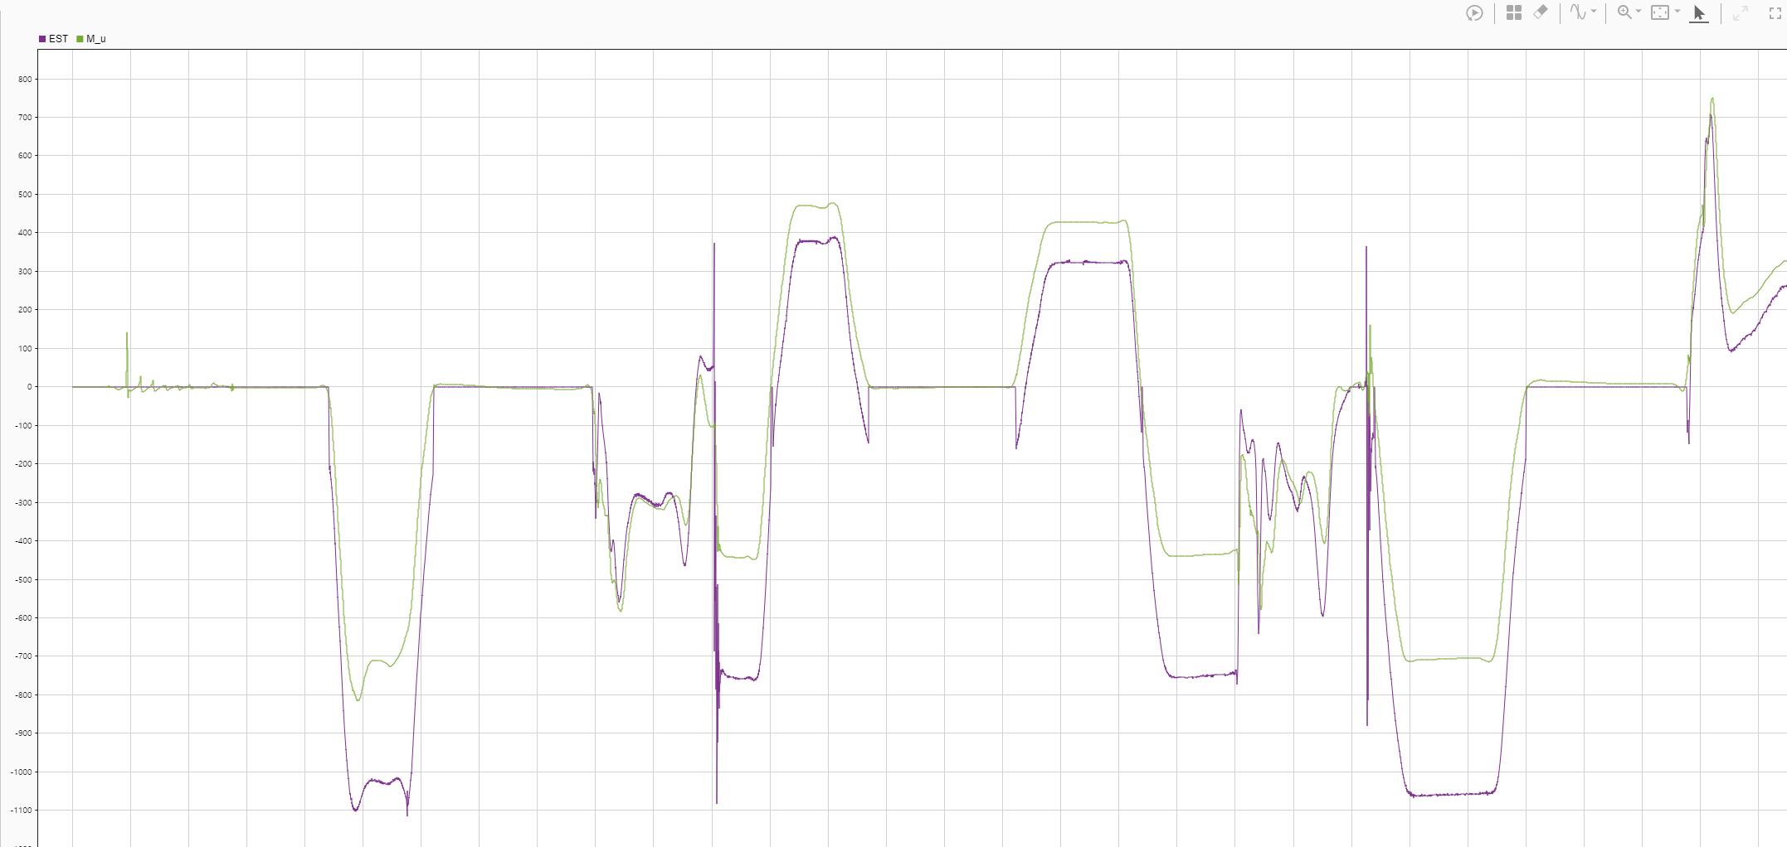
LSTM(10) layer(1)

Slide 10
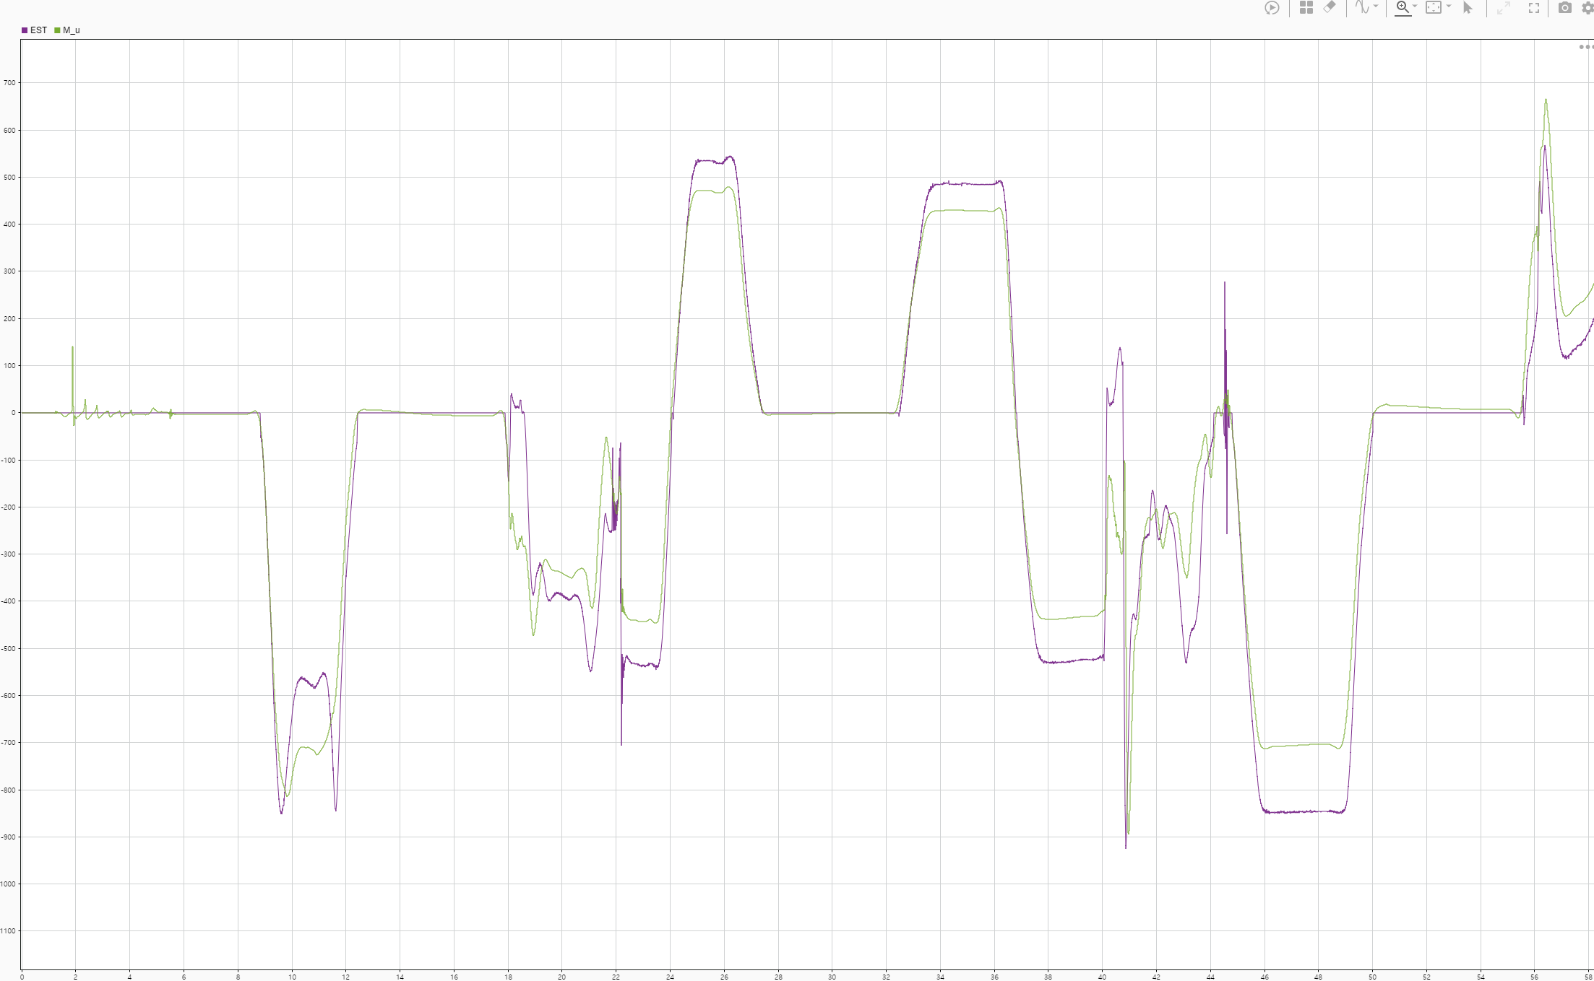
LSTM(40) layer(1)

